Slide 1
E-Lok Geet
Presented By :
Ashwini Varma (IT-2K9-07)
Keshav Patidar (IT-2K9-20)
Prathmesh Dubey (IT-2K9-29)

Slide 2
Contents
Problem Definition
Goal of Project
List of Stakeholders
Constraints
Scope
Gantt Chart
Feasibility Study
Software Requirement Specification
Software Design
Input Output Forms
Testing

Slide 3
Problem Definition
E-Lok Geet is a website which aims at providing users with facility to provide (listen and download) lok (folk) music anywhere and anytime.
Moreover, it also provides users with facility to manage their favourite playlist.

Slide 4
Goal of Project
Make Songs (Lok Geet) available to user anywhere and anytime for listening as well as for downloading.
Facilitates effective way of organising songs (according to their movies).
Facilitates user to manage their favourite songs list in an efficient manner.
Facilitates availability of latest songs too.
Facilitates feedback system so that this system can be further improved.
Should be easy to use.

Slide 5
List of Stakeholders
Admin : One who administers the system. Performs activities like Upload Songs, Delete Songs, Feedback Management, Change user roles, etc.
User : One who is a member of system. Activities like Linking Songs, Unlinking Songs, Managing Own Account, etc. are related to a user.
Guest : One who does not have login id and password of the system. Can only download songs, listen songs and give feedback.

Slide 6
Constraints
Software Constraints
The application strictly requires its execution on internet connection.
As in this case response time is of major concern as multiple users would be simultaneously giving request. So, the API which allows fastest communication between Database and user's request should be chosen. In this case JSP is being used, then Pure Java API should be used for database connectivity.
Hardware Constraints
Server should have sufficient hard disk space to store songs of movies.
User Interface Design Constraints
As songs are being listened by a variety of users. So, user interface should be designed keeping in mind of even those users who are new to computers and internet.

Slide 7
Scope
In Scope :
Authentication : Admin/User have to login before accessing their respective features of E-Lok Geet.
Listen Songs : Users/Guest can listen to songs online.
Download Songs : Users/Guest can download songs.
Upload Songs : New Songs can be uploaded by admin.
Delete Songs : Corrupt or non-essential songs can be deleted in case of server overload by admin.
Favorite Songs List : Users can manage their favorite songs list.
Feedback Management : Users/Guest can give feedback and Admin can check the feedbacks and reply accordingly.
Register : Guest can register to become member (user) of E-Lok Geet.

Slide 8
Scope (Continued)
In Scope :
Account Management : Users/Admin can manage their account details like Name, Authentication Password, etc.
Change User Roles : Admin have authority to give another user admin privileges.
Out Scope :
In E-Lok Geet songs are classified only according to movies. That means, in E-Lok Geet only movies songs are present. Songs are not classified according to Albums or Artist.

Slide 9
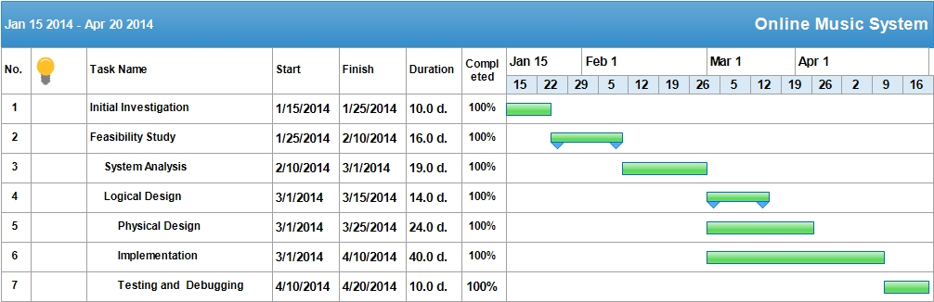
Gantt Chart

Slide 10
Feasibility Study
Economic Feasibility
As far as the benefits of the project are concerned the cost is quite negligible. The main cost is of the system used to access this project. But that does not concern us as the systems that are used to access the project will be clients systems. Hence, this project is economically feasible.
Technical Feasibility
This project is technically feasible as it has got all features necessary to form a healthy environment for communication. The concepts and technology used in this project are perfectly well and secure. And all the requirements of the system can be implemented.

Slide 11
Feasibility Study (Continued)
Behaviour Feasibility
Since now a days most of the people are familiar with the basic use of computers and since this project is being made in very user friendly way so that anyone with basic knowledge of computer can use it, so this project implementation will not hamper the environment or will not affect any user’s behaviour.

Slide 12
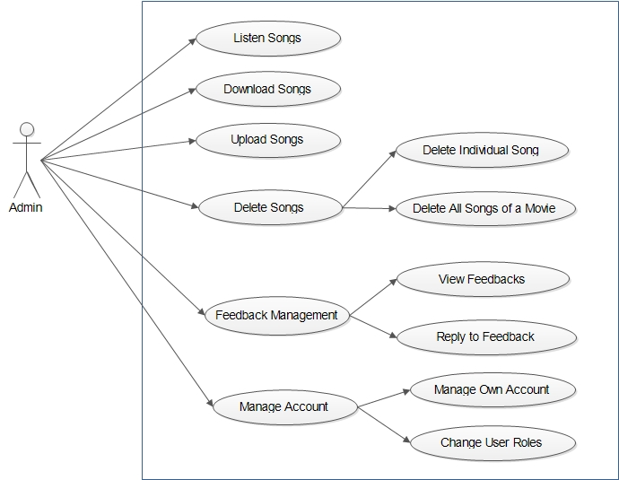
Software Requirement Specification
Functional Requirements
Use Case for Admin

Slide 13
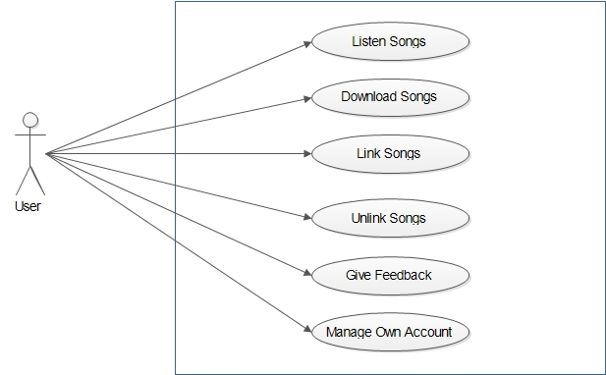
Use Case for User

Slide 14
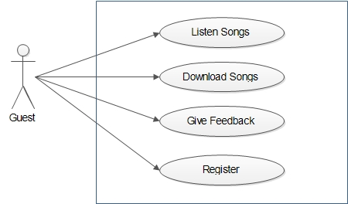
Use Case for Guest

Slide 15
Non Functional Requirements
Reliability
The system should provide mechanism to detect any invalid values and should be able handle exceptions very efficiently.
Moreover, system should use powerful DBMS and Server which do not crash.
Usability
This system should be very easy to use. It should use graphical user interface components like combo box, list, radio buttons, etc. which are very easy to understand by user.
Moreover, songs should be categorized according to their movies. It will increase readability and decrease complexity of the system.

Slide 16
Security
System should provide measures to prevent software from unauthorized access of data.
Reusability
The software should be made on concept of Object Oriented Programming and Component Based Assembly so that its Components can be reused again.
MVC (Model View Controller) approach should be used as it facilitates reusability.

Slide 17
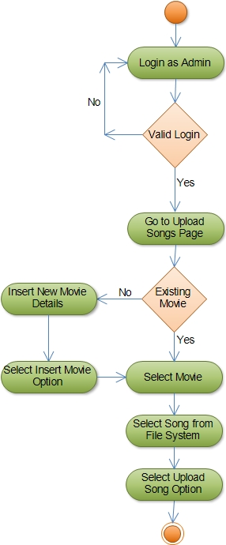
Software Design
Activity Diagram
Upload Songs

Slide 18
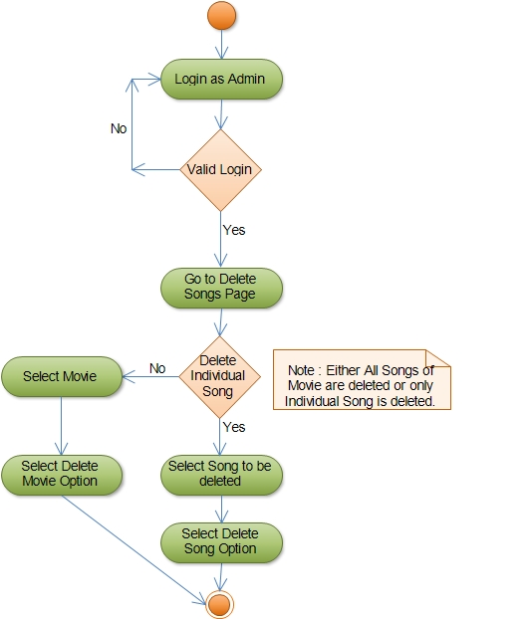
Delete Songs

Slide 19
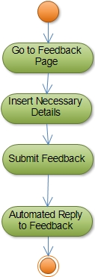
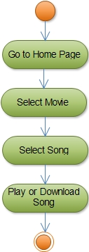
Give Feedback
Play or Download Songs

Slide 20
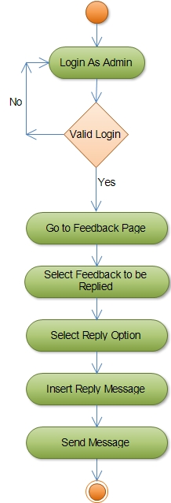
Feedback Management

Slide 21
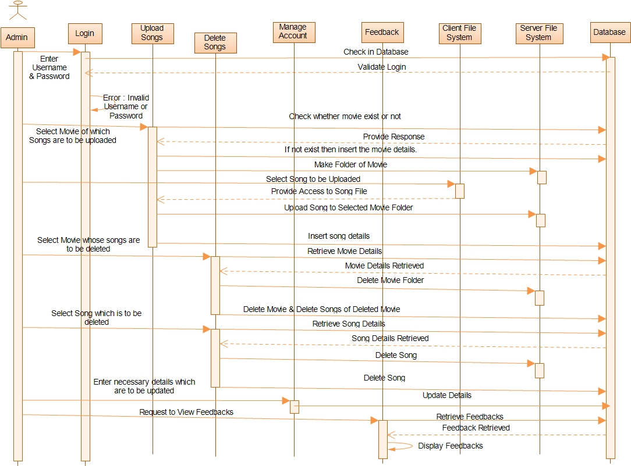
Sequence Diagram
For Admin

Slide 22
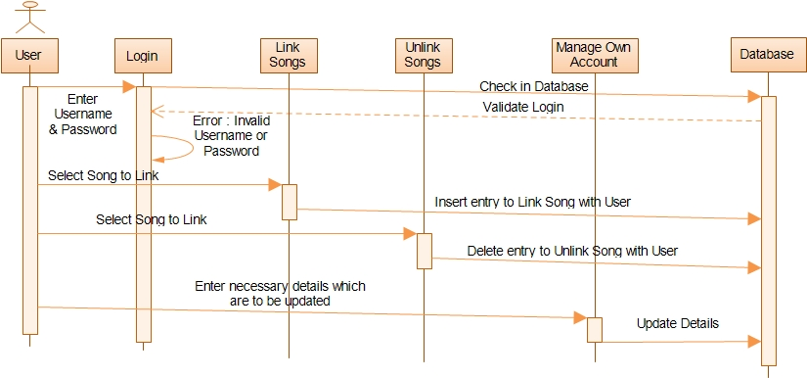
For User

Slide 23
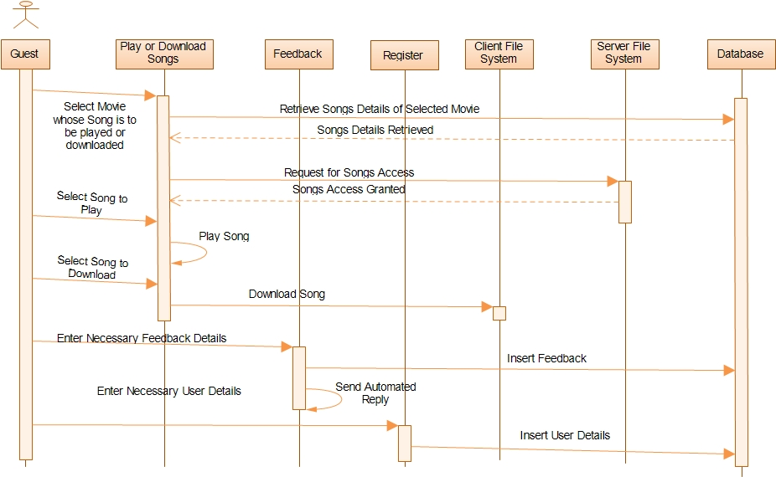
For Guest

Slide 24
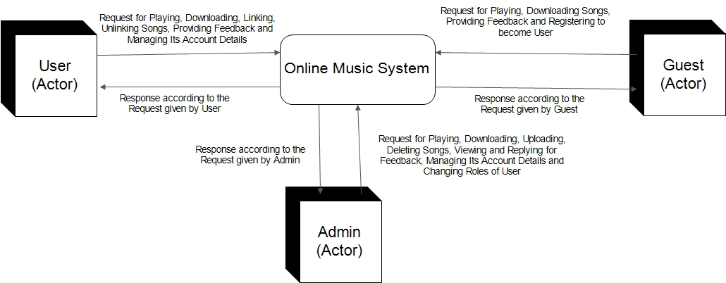
Data Flow Diagram
Context DFD

Slide 25
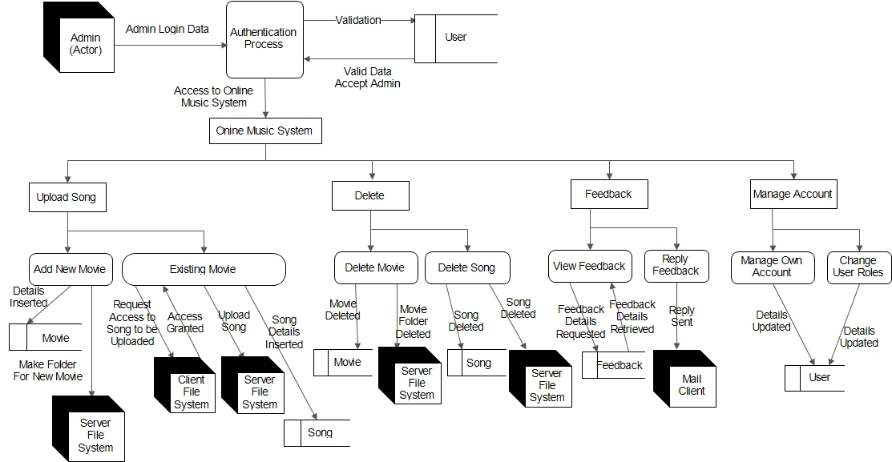
Level 1 DFD for Admin

Slide 26
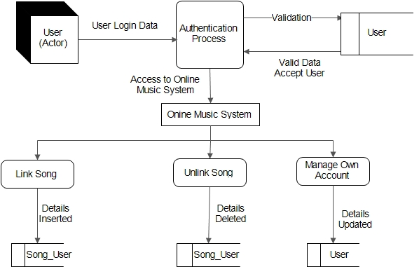
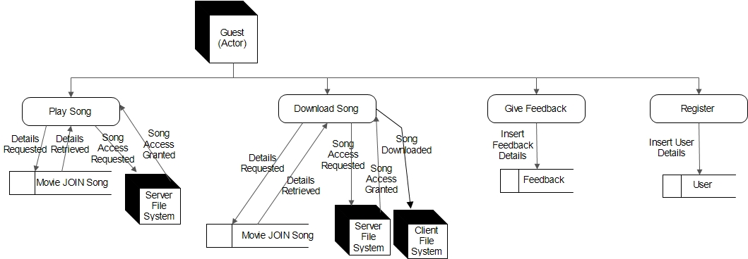
Level 1 DFD for User
Level 1 DFD for Guest

Slide 27
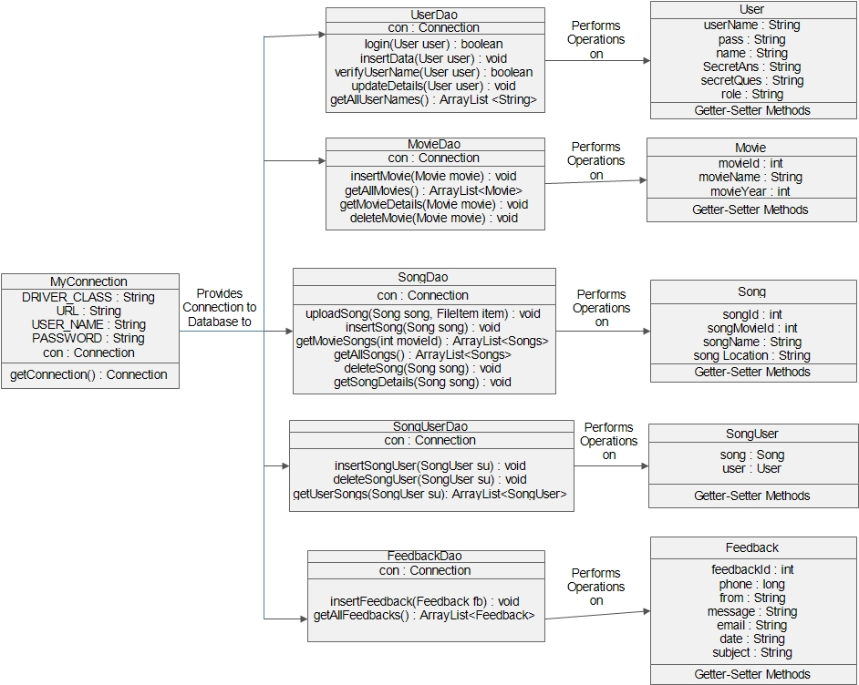
Class Diagram

Slide 28
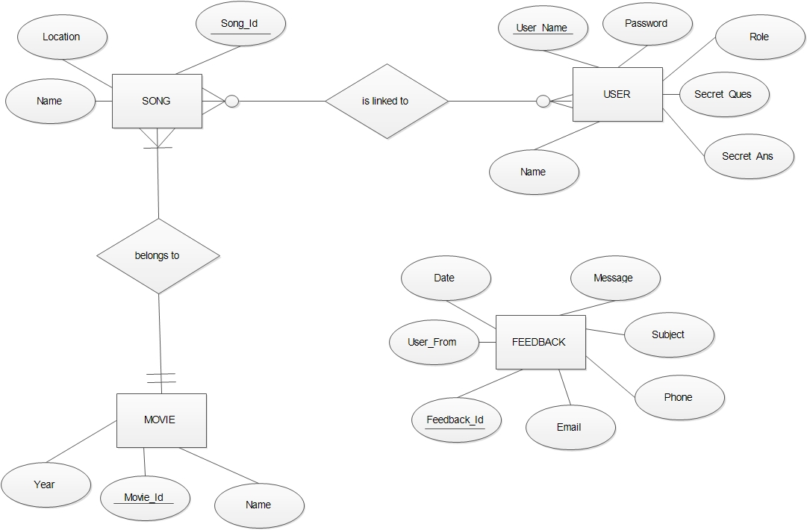
E-R Diagram

Slide 29
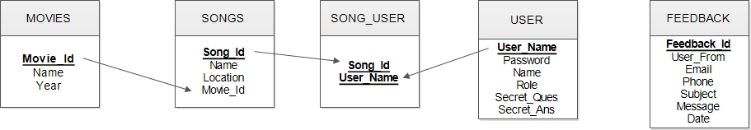
Conceptual Data Design

Slide 30
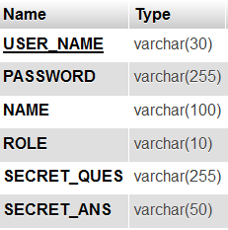
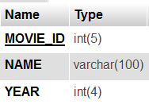
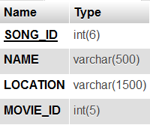
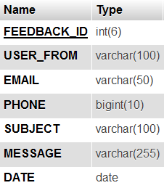
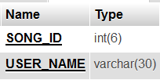
Physical Data Design
USER
MOVIES
SONGS
SONG_USER
FEEDBACK

Slide 31
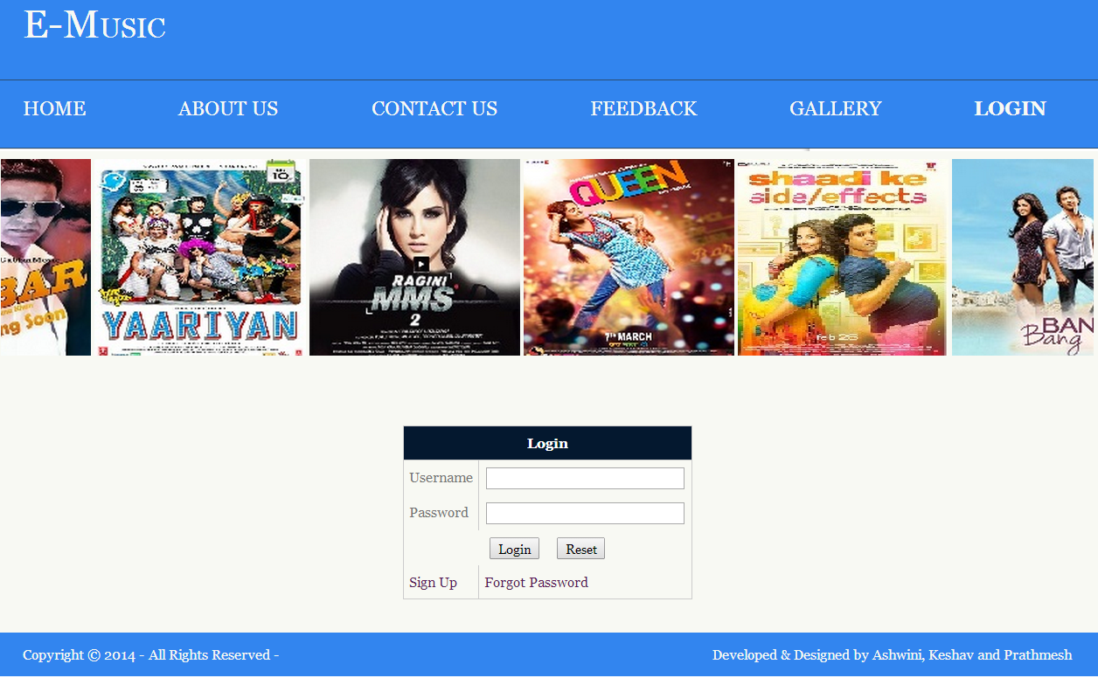
Input Output Forms

Slide 32
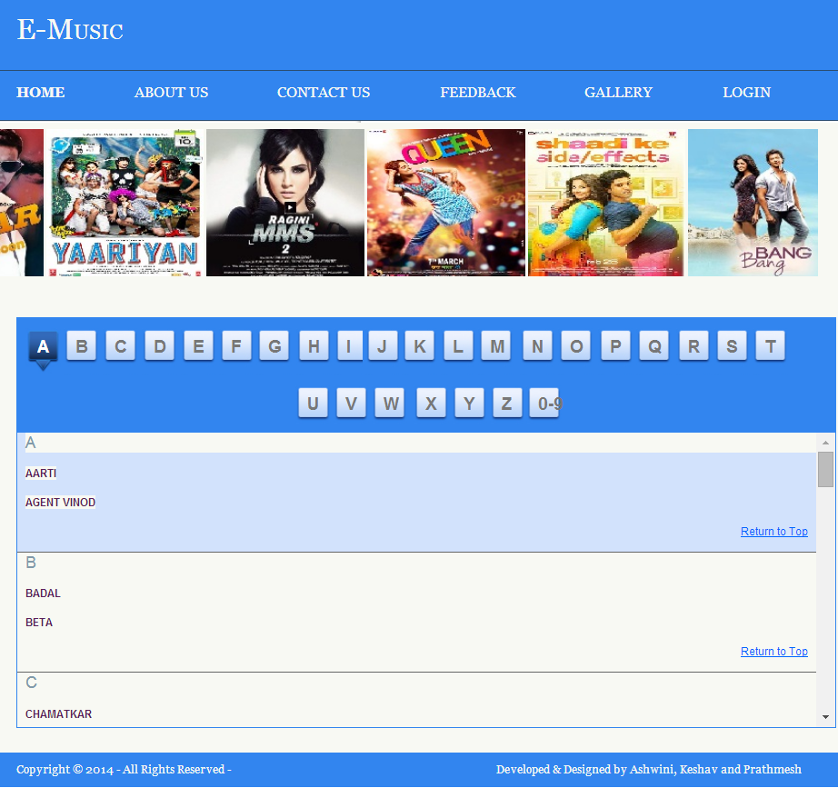

Slide 33
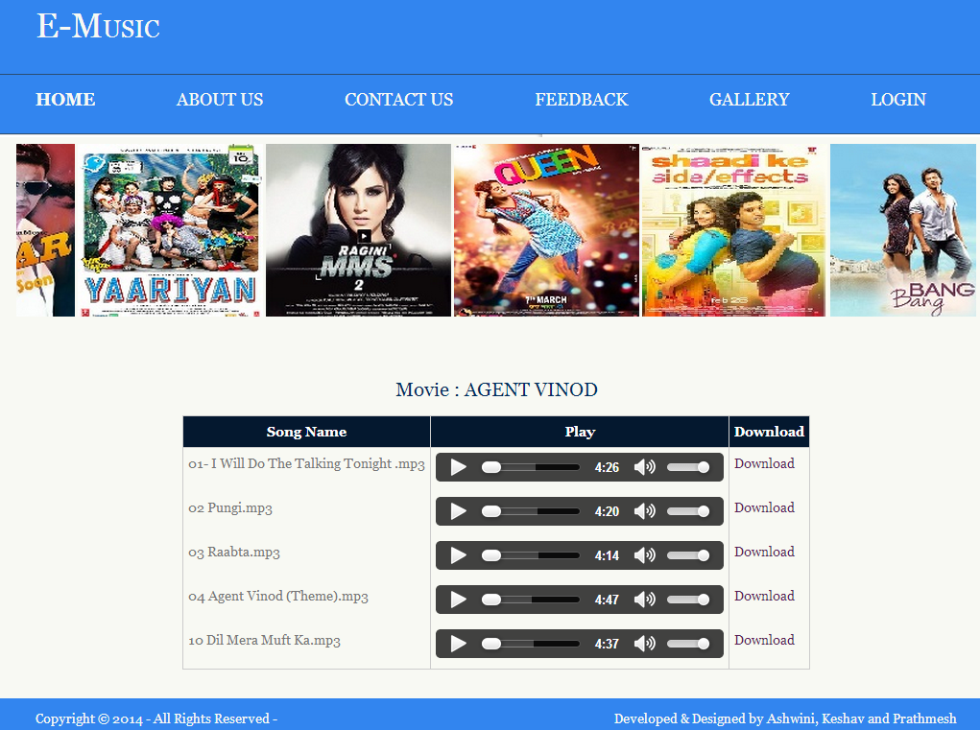

Slide 34
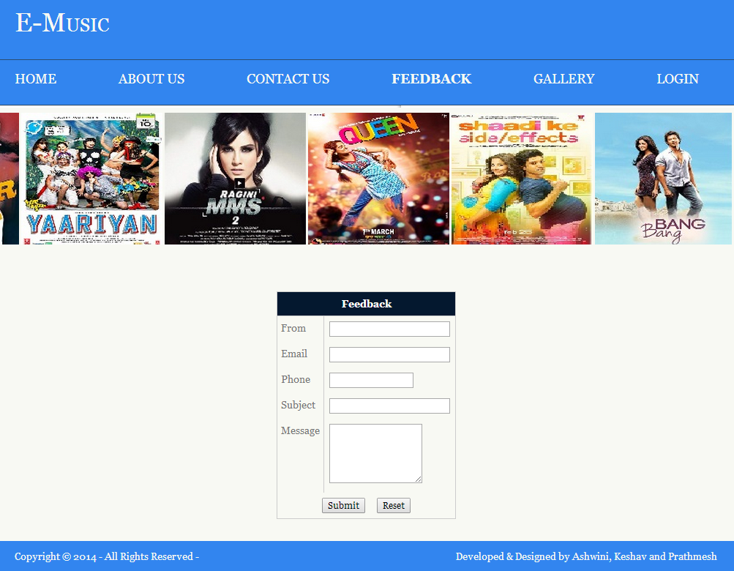

Slide 35
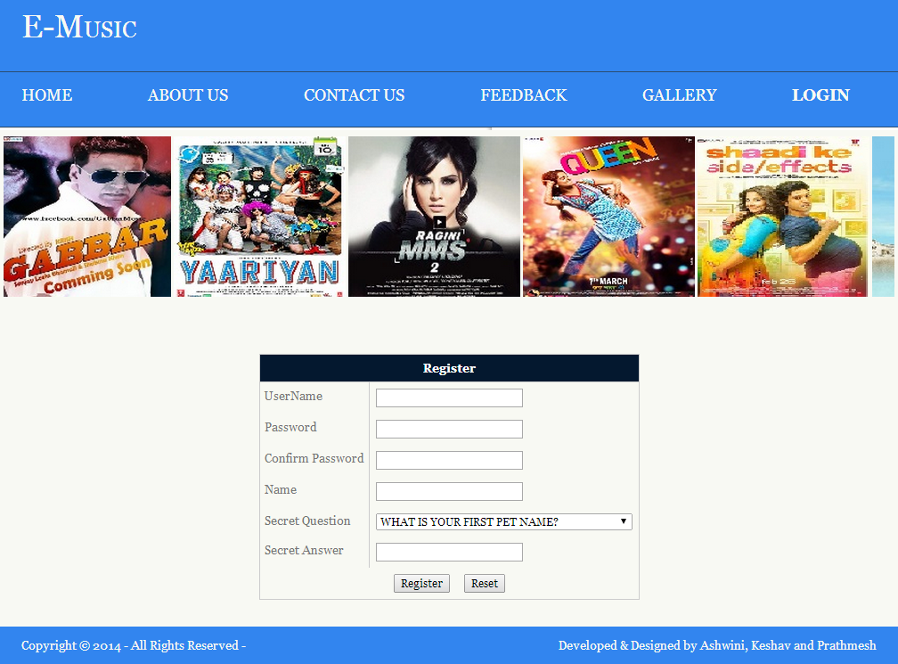

Slide 36
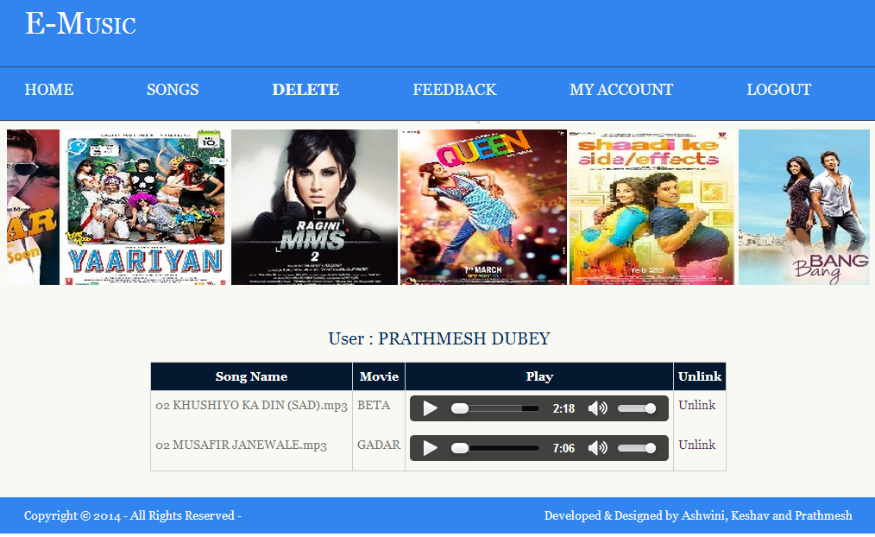

Slide 37
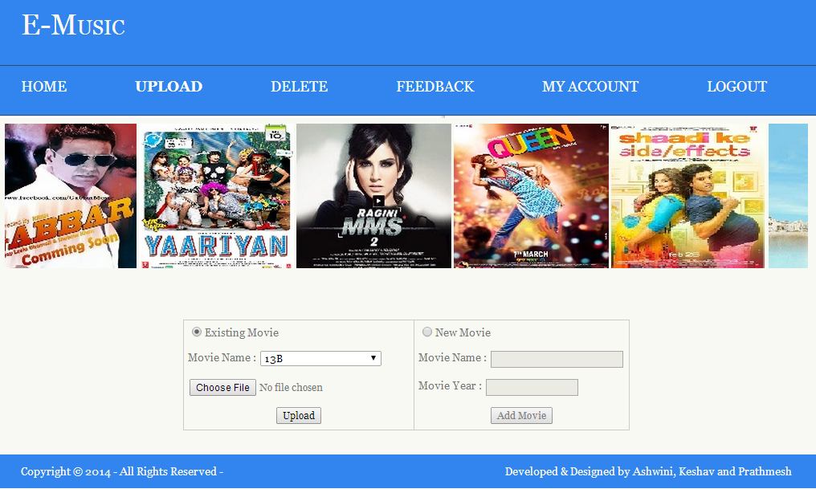

Slide 38
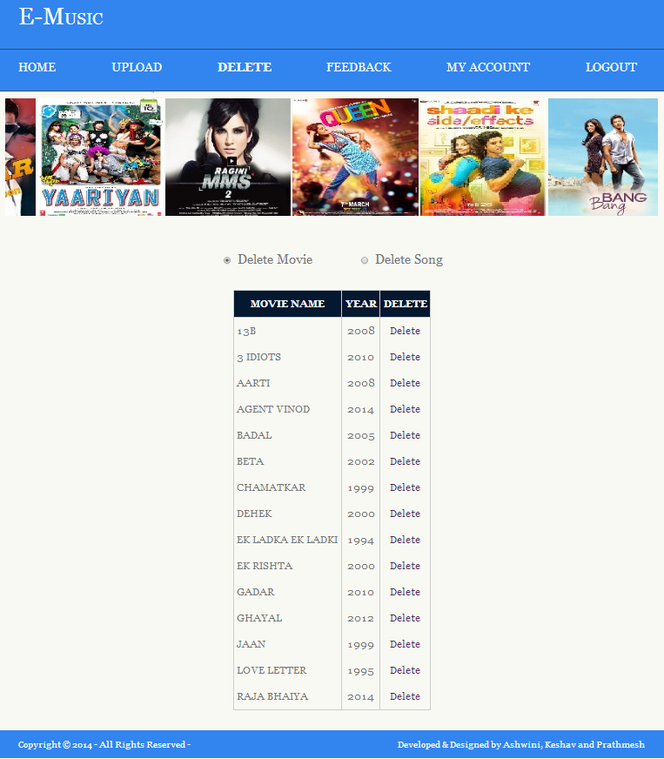

Slide 39
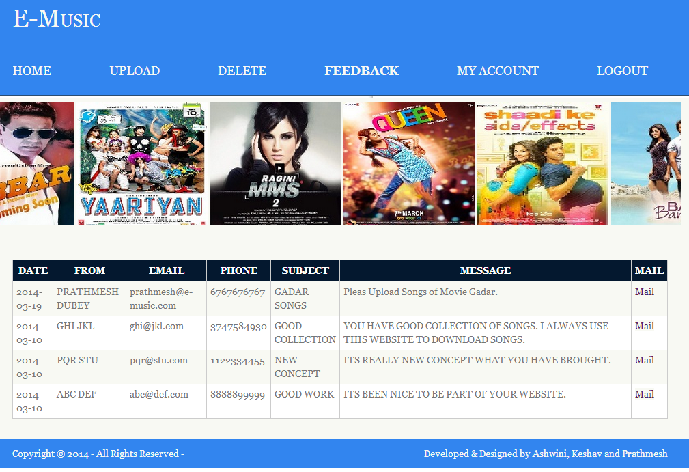

Slide 40
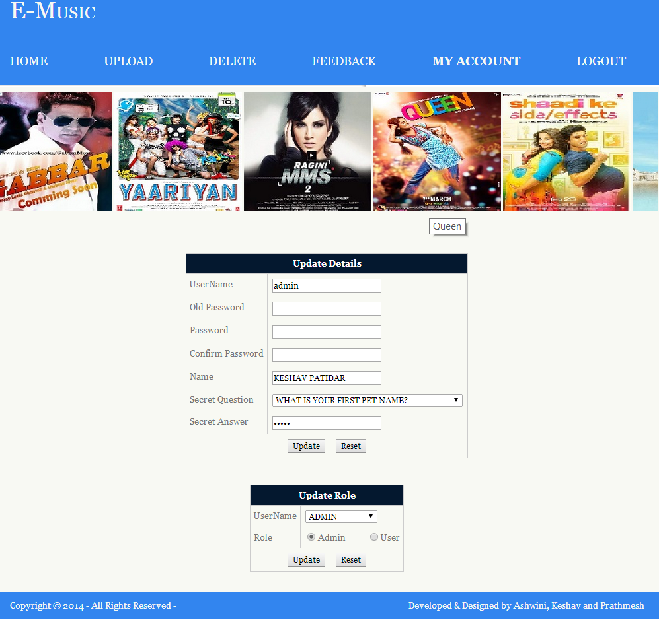

Slide 41
TESTING
Unit testing
Individual functions or procedures are tested to ensure that they are operating correctly. Each component is tested individually.
In this case, functions like insert, delete, update records in database are tested whether they are performing their functions properly or not.
Module testing
A module is a collection of dependent components such as an object class, procedures and functions.
In this case Upload Song module, Delete Song module, Feedback Management module, etc. are tested individually.
Sub-System testing
Sub-System testing involves testing a collection of modules which have been integrated into sub-systems.
In this case, all modules related to Admin, User and Guest are considered different sub systems. So, these subsystems are tested individually

Slide 42
Testing (Continued)
System testing
The sub-systems are connected together to make the whole system.
Whole system is tested whether it is working properly or not.
Black Box testing
In this, it is checked whether all the requirements (specifications) are being fulfilled by the system or not

Slide 43
Testing (Continued)
Some Test Cases
Login
Test Case | Expected Outcome
Valid Login Id and Password | If Login Id is of Admin then redirect to Admin Home Page else redirect to User Home Page.
Invalid Login Id or Password | Display Error Message on Login Page

Slide 44
Register
Insert New Movie
Test Case | Expected Outcome
Valid Details required for registration | Data should be inserted in database. And Message should be provided that registration successful.
Invalid Details inserted | Display Error Message on Register Page
Test Case | Expected Outcome
Valid Details required for registration | Data should be inserted in database. And Message should be provided that movie inserted.
Invalid Details inserted | Display Error Message

Slide 45
Upload Songs
Test Case | Expected Outcome
Valid Song and its corresponding movie selected | Data should be inserted in database as well as on server file system. And Message should be provided that song uploaded successful.
Invalid Details inserted | Display Error Message on Song Upload Page.

Slide 46


